Slide 1
Introduction to Docker
Basics of building Docker images, sharing them using image registries, orchestrating systems with Docker, and much more.
PRESENTED BY:
Sergey Tantsyura
Maxim Nakhod
Date: October 17, 2019

Slide 2
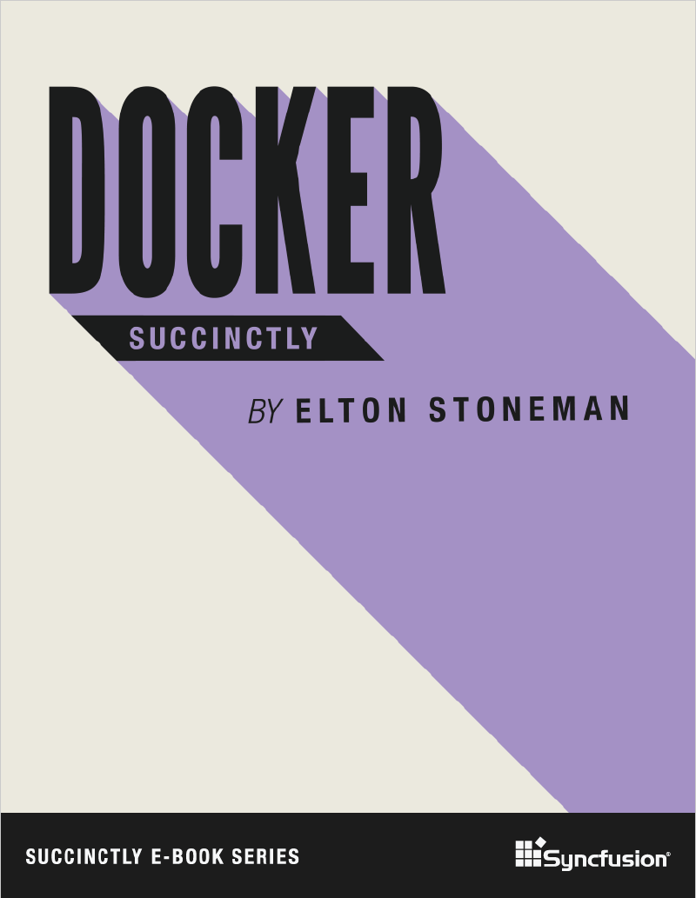
Disclaimer
Content of this training is based on Docker Succinctly e-book.
Succinctly e-book series is a great way to quickly get familiar with new technologies. These e-books are free and most of them are between 50 and 100 pages.

Slide 3
Agenda
01
02
03
04
05
06
Introducing Docker
Creating Docker images
Image registries and Docker Hub
Data Storage in Docker
Orchestrating Systems with Docker
Clustering Hosts with Docker Swarm
Notes:
01, 03, 05, 07 (??????????????????????) – STA
02, 04, 06 – MN
Samples:
01
run SQL server Linux container
Run some windows container
02
create ASP.NET Core app and package it into container
Multi-stage build, first stage builds from sources, second stage packages output of first stage
03 – push created image to image registry, show script
MN to provide link to registry + set access rights
04
add logging, show how to mount folder where logs will be written to.
??? – use folder for DB files in SQL server
05
Start SQL + web app simultaneously, pass connection string to sql server via env variable
+ update web app to use data from DB
06
Run apps from 05 in Docker Swarm
07
??????????????????????????????????????? Kubernetes

Slide 4
Introducing Docker

Slide 5
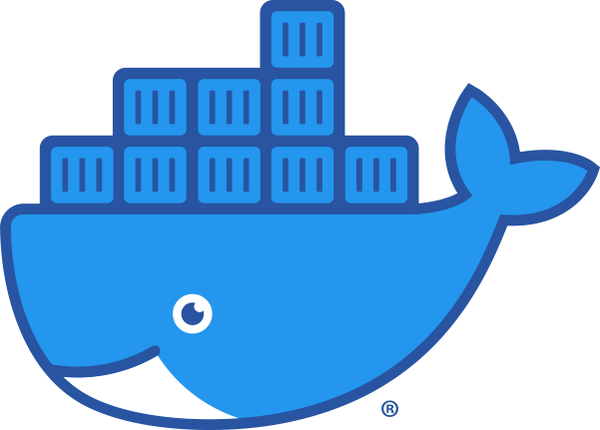
What is Docker?
Docker is an application platform. It lets you package your application with everything it needs, from the operating system upwards, into a single unit that you can share and run on any computer that has Docker. Docker runs your application in a lightweight, isolated component called a container.

Slide 6
Advantages of Docker
The application package, called a Docker image, is typically only tens or hundreds of megabytes, so it’s cheap to store and fast to move.
When you run a container from the image, it will start in seconds and the application process actually runs on the host, which means you can run hundreds of containers on a single machine.
Images can be versioned, so you can be sure the software you release to production is exactly what you’ve tested.
With Docker, you can build your application image and know that it will run in the same way on your development laptop, on a VM in an on-premise test lab, or on a cluster of machines in the cloud.

Slide 7
Advantages of Docker
Docker is open source and cross-platform, and one of its ecosystem’s most compelling aspects is the Docker Hub—a public registry where organizations and individuals share their own application container images.
In Docker, the packaging process is where development and operations meet, which means it’s a great start for the transition to DevOps. And having a framework for orchestrating work between many containers gives you the foundation for microservice architectures.

Slide 8
Installing Docker
Docker is a single product which has three components:
Background server that does the work;
Docker client, a command-line interface for working with the server;
REST API for client-server communication.
The client is cross-platform, which means you can run it natively from Linux, Windows, and OS/X machines, and you can manage Docker running locally or on a remote machine.
The Docker server runs on Linux and on the latest versions of Windows.

Slide 9
Installing Docker
The Docker team has put together packages for Mac and Windows that make use of virtualization technology on the host so that your Docker server runs inside a Linux VM on your OS/X or Windows machine (you run the client locally and talk to the server through the REST API exposed on the VM).
On Windows, you’ll need to have Hardware Virtualization (VT-x) enabled in the BIOS to run the Docker Linux VM, and after installing you’ll need to reboot.
You can switch between Windows containers and Linux containers

Slide 10
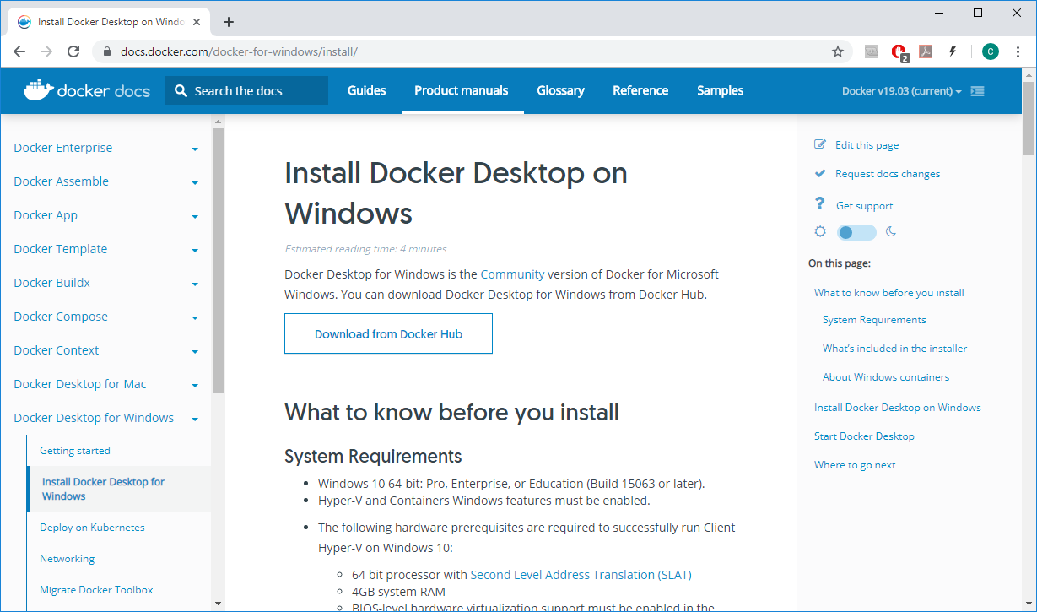
Installing Docker

Slide 11
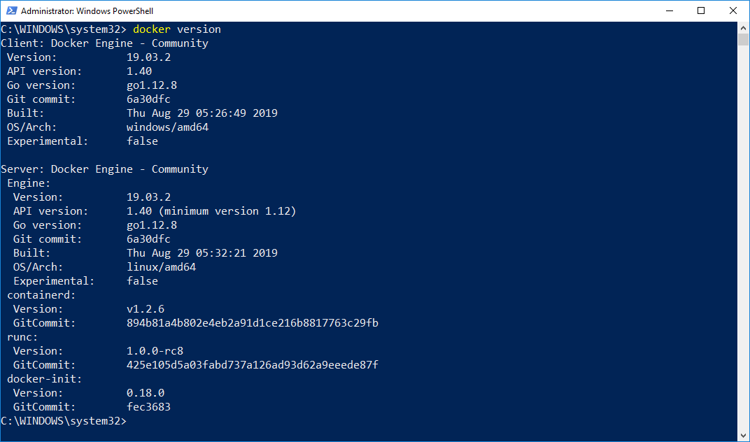
Installing Docker
After Docker Desktop is installed, try running docker version command

Slide 12
Running containers
Docker images are packaged applications. You can push them to a central store (called a registry) and pull them on any machine that has access to the registry. The image is a single logical unit that contains the application package. In order to start the app, you run a container from the image.
Images are typically built to run a single process. If your app needs to work with other services, you run those services in their own containers and orchestrate them so that all the containers can work together
When you run a container from an image, it may be a short-lived app that runs some functionality and then ends; it may be a long-running app that runs like a background service; or it may be an interactive container that you can connect with as though it was a remote machine.

Slide 13
Running containers
Run a command in a new container:
docker container run [OPTIONS] IMAGE [COMMAND] [ARG...]
Frequently used options:
Option | Description
-d, --detach | Run container in background and print container ID
-e, --env list | Set environment variables
-i, --interactive | Keep STDIN open even if not attached
--name string | Assign a name to the container
-p, --publish list | Publish a container's port(s) to the host

Slide 14
Managing containers
Manage containers:
docker container COMMAND
Frequently used commands:
Command | Description
exec | Run a command in a running container
ls | List containers
rm | Remove one or more containers
run | Run a command in a new container
stop | Stop one or more running containers

Slide 15
Running containers
DEMO
Notes:
Sample commands can be found in src/01_Introducing_Docker
When connecting to SQL Server using SQL Server Management Studio, specify “localhost,14330” as server name
Show switching from Linux containers to Windows containers, show output of “docker version” command after switching.
Mention requirement to install updates to be able to run Windows containers. Show output of “docker version” command, it includes system architecture.

Slide 16
Creating Docker images

Slide 17
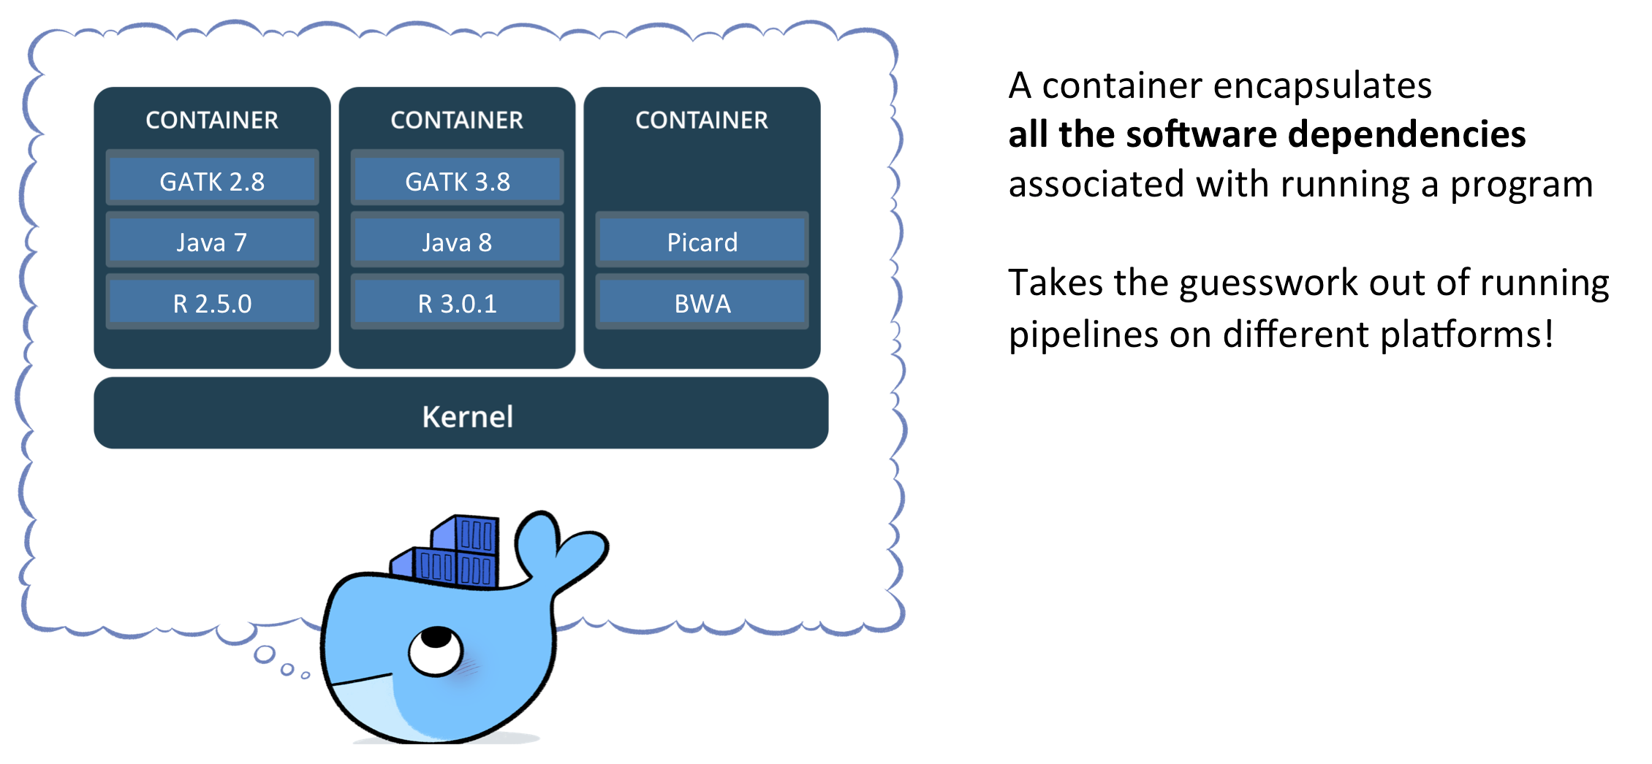
The world base is not enough
Containers must work right after start, so images must contain all required software and settings and do not require any configuration afterwards.

Slide 18
Welcome dockerfile
FROM ubuntu
RUN apt-get update && apt-get install nano
Notes:
Dockerfile can be named anyhow, but dockerfile is a standard name

Slide 19
Build process
Build process is executed by the docker service/daemon
Build context and docker file are sent to service to create an image

Slide 20
Build process. Layers
Each command in a docker file creates a new “temp” image. So result image is set of layers.
All temp images are cached and used when possible
ENTRYPOINT command
FROM mcr.microsoft.com/dotnet/core/aspnet:3.0
COPY bin/Debug/netcoreapp3.0/*.* ./
ENV ASPNETCORE_URLS=http://+:5000
EXPOSE 5000
ENTRYPOINT ["dotnet", "SampleWebApp.dll"]
EXPOSE command
ENV command
COPY command
Base image

Slide 21
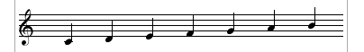
Commands you can use
There are just 12 commands you can use.
Not so many but …
there are only 7 notes used to create all music ☺
https://docs.docker.com/develop/develop-images/dockerfile_best-practices

Slide 22
Commands you can use
Defines base image for the image
The only mandatory command
Notes:
Use official images where possible
Use version tags to avoid latest hell
FROM

Slide 23
Commands you can use
Runs a command in the build context
Notes:
Each run command creates a new layer – better to compose several in 1 line
Cache is used, so you may have weird behaviour
RUN

Slide 24
Commands you can use
Copy files from build context to the image
Notes:
Wildcards can be used
Only files from build context is available, but not the whole FS
COPY

Slide 25
Commands you can use
Sets default execution command for the container
Notes:
Should be only 1 in a dockerfile
Might be omitted
CMD

Slide 26
Creating docker images
DEMO
Notes:
Sample commands can be found in src/01_Introducing_Docker
When connecting to SQL Server using SQL Server Management Studio, specify “localhost,14330” as server name
Show switching from Linux containers to Windows containers, show output of “docker version” command after switching.
Mention requirement to install updates to be able to run Windows containers. Show output of “docker version” command, it includes system architecture.

Slide 27
Image registries and Docker Hub

Slide 28
About image registries
Packaging an application into a container image is easy with the docker image build command, but the image only gets created in the local image cache on your own machine.
In order to make that image useful, you need to be able to ship it to different hosts, and that’s where image registries come in.
A registry is simply a shared location for images—you can push images you’ve created and pull images that you or other people have created.
The registry is a core concept in Docker, and you use the normal Docker command-line tool to work with registries.

Slide 29
About Docker Hub
The Docker Hub is a free, public registry for images maintained by Docker, Inc.
It is a hugely popular service— there is more than a million of images on the Hub.
Anyone can push images to the Hub, and in addition to the community images, there are also official images curated by Docker and supported by their owners.
Docker Hub is the default source and has a very useful feature set that makes it much more than just an image store. However, if you’re not comfortable storing your own application images in a third-party cloud service, there are many other options.

Slide 30
Using Docker Hub
You will need your own account on Docker Hub if you want to push images and share them.
You can register with Docker Hub at https://hub.docker.com and create a free account.
The username you choose will be the user part of the repository name when you build your own images (my username on Docker Hub is tantsyurasergey, and I can only push images which are prefixed tantsyurasergey).
Docker Hub can be used for storing private repositories, too, and the free plan lets you store one private repository and unlimited public ones.

Slide 31
Pushing images
When you have an account registered with the Docker Hub, you will need to add your credentials to the Docker CLI using the following command:
docker login
After logging in, you will be able to push images as well as pull them. The image push command is very simple:
docker image push [OPTIONS] NAME[:TAG]
The push works intelligently, pushing only layers that aren’t already available in the registry. Only the new layers created by building my Dockerfile get pushed.

Slide 32
Pulling images
Image size can be a few megabytes or many gigabytes, so pulling large images might take a while, which means startup time for a new container can jump from seconds to minutes.
In order to prevent that, you can explicitly pull images from the Hub and download them before they are needed, so that when you do run a container it uses the local image:
docker image pull [OPTIONS] NAME[:TAG|@DIGEST]

Slide 33
Tags and image versions
Docker image repositories use the basic format {user}/{app}, but often the tag is used to specify a release version, or a variant of the image, in the format {user}/{app}:{tag}.
If you don’t specify a tag when you refer to an image, the default latest tag is used.
One image can have multiple tags. Tags can be version numbers, commit labels, codenames—any useful way to classify images.
It’s important to specify a tag for base images in your FROM instruction. If you don’t, the image tagged as latest will be used. That tag can change to a different image without warning, and there can be breaking changes between image versions, which means your own images might fail to build.

Slide 34
Choose your base image carefully
Content

Slide 35
Running your own registry
Content

Slide 36
Running containers
DEMO
Notes:
Sample commands can be found in src/03_Image_registries_and_Docker_Hub

Slide 37
Data Storage in Docker

Slide 38
Docker follows 12 factor app principles
«The twelve-factor app never assumes that anything cached in memory or on disk will be available on a future request or job»
https://12factor.net/processes

Slide 39
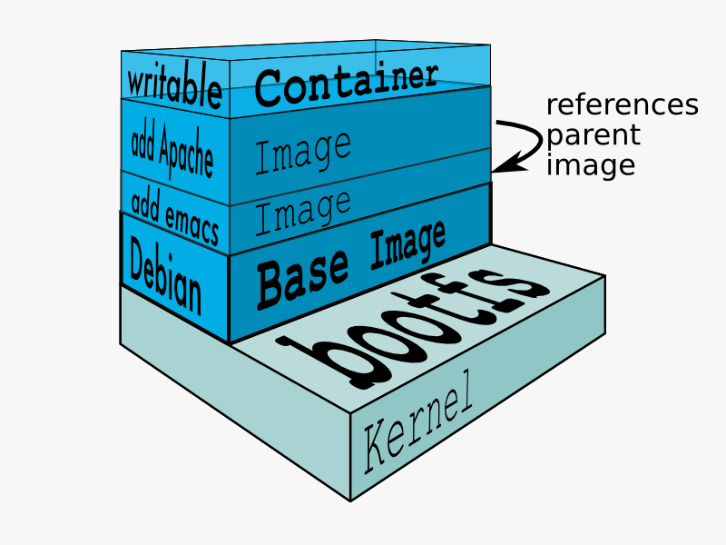
Layered File System
Each container has its own RW layer in file system, but base images FSs are RO
As a result, each container starts exactly in the same state as other containers started from the same image

Slide 40
Stateless containers
DEMO
Notes:
Sample commands can be found in src/03_Image_registries_and_Docker_Hub

Slide 41
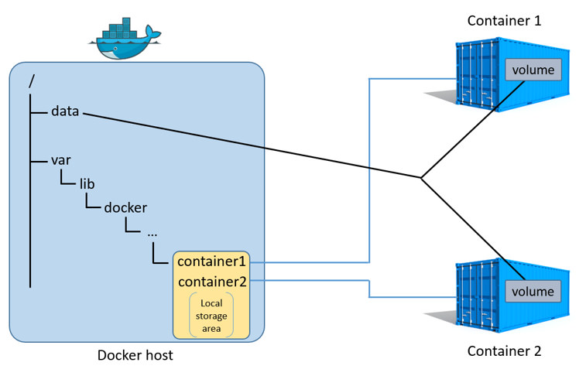
Rules are there to break them
If you want to persist data or share data between containers use VOLUMEs
docker run … -v mssql:/var/opt/mssql mcr.microsoft.com/mssql/server:2019-CTP3.2-ubuntu

Slide 42
Logs sharing
DEMO
Notes:
Sample commands can be found in src/03_Image_registries_and_Docker_Hub

Slide 43
Summarize data sharing
Volumes might be used
You may share:
Data volumes (DBs, indexes)
Folders (folder to write logs to)
Files (e.g. license)

Slide 44
Orchestrating Systems with Docker

Slide 45
Header
Content

Slide 46
Clustering Hosts with Docker Swarm

Slide 47
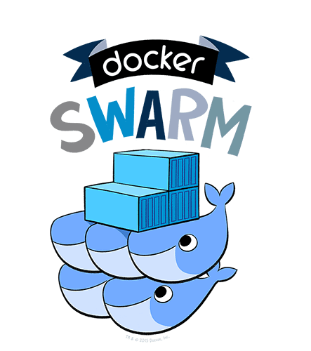
Docker Swarm
Adjust power with 1 command

Slide 48
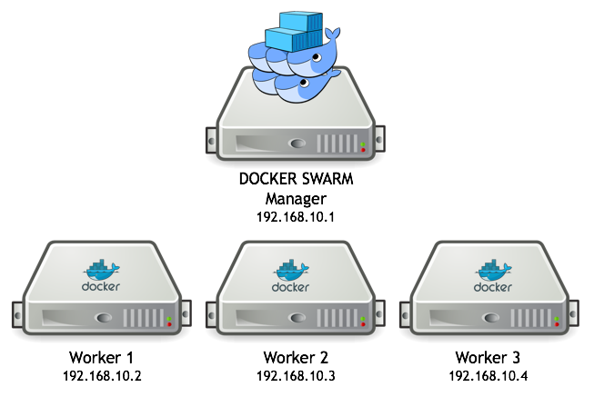
Setting up a cluster
docker swarm init
docker swarm join …
That’s it ☺

Slide 49
Service is almost a container but better
Service is an abstraction over container

Slide 50
Service creation
docker service create --name web --publish 80:80 nginx:alpine

Slide 51
Scale service
docker service scale web=5
docker service ps web

Slide 52
Mixed swarm environment
You may have nodes on Windows, Linux and even ARM

Slide 53
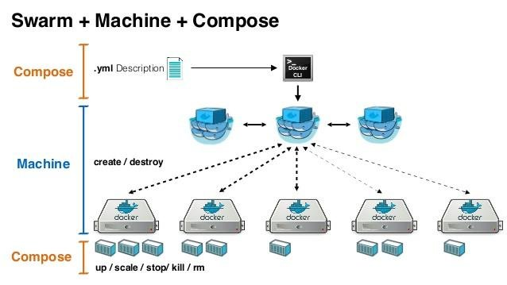
A cherry on top
Docker swarm + docker compose

Slide 54
Notes
Use the latest available docker when playing with swarm
Consider using docker-machine tool to create “dokernized” VMs

Slide 55
Q&A

